Slide 1
Model interpretability
Slides taken from
Scott Lundberg’s presentation on Shapley values based model intepretability
DeepLift slides by Avanti Shrikumar
Integrated gradients slides by Ankur Taly

Slide 2
Model interpretability

Slide 3
Why?!
chance John will have repayment problems
model
55%
No loan
John, a bank customer
Why?!
AI magic!
Notes:
We'll start with a simple motivational example. This is John, a typical bank customer. Like many consumers today, when he applies for a loan, information about him is sent through a predictive model XX.
This model is designed to calculate the risk that John will have repayment problems, XX which, unfortunately for John, is 55%. And because his risk is high, the bank declines his loan application XX.
A natural first question John has XX is “Why?” The bank XX also want to know why, because these are key business decisions. But unfortunately for the data scientist that built this model XX, she used a complex model and so these questions are hard to answer XX …. XX

Slide 4
 | Interpretable | Accurate
Complex model | ✘ | ✔
Simple model | ✔ | ✘
Interpretable or accurate: choose one.
😀 ⚖️
💰
Notes:
The reason the data scientist used a complex model is because they are often very accurate on large data sets XX, but that same complexity also makes them hard to interpret XX. In contrast, simple models are easy to interpret XX, but are often less accurate XX. This leads to a trade-off XX between interpretability and accuracy.
This trade-off is particularly painful for the bank since accuracy directly corresponds to profitability XX, while interpretability has important implications for customer satisfaction XX and even legality. This tradeoff effects a wide range of applications, and so many recent methods have been developed to address it. XX

Slide 5
Input value
Output value
Complex models are inherently complex!
But a single prediction involves only a small piece of that complexity.
Notes:
These methods do not try and make an entire complex model interpretable, because there is inherently too much to succinctly explain. Instead they focus on explaining a single prediction XX, because mapping a single input to an output involves only a small part of the complexity of the overall model. XX

Slide 6
data
model
prediction
.
.
.
Notes:
How do we explain the prediction of a potentially complex model?
One approach is to change the model inputs, where x_1 could for example represent John’s age, and see how the model behaves. By hiding XX such a feature from the model … XX, or a set XX of features, we can learn about how features effect the model’s output. XX
If we want to summarize these effects, we can attribute an importance value to each feature XX, and replace the model with a simple sum. XX

Slide 7
data
prediction
.
.
.
Notes:
These feature attributions approximate the effect of hiding XX features from the original model. XX

Slide 8
data
prediction
.
.
.
Notes:
Note that these attributions are specific to the model, f, being explained, and also, x, the input data used for this prediction.
It turns out that this way of explaining a model’s prediction, as a sum of feature attributions, is widely used. XX

Slide 9
LIME
DeepLIFT
LIME
Ribeiro et al. 2016
Shrikumar et al. 2016
Shapley reg. values
Shapley reg. values
Relevance prop.
Lipovetsky et al. 2001
Bach et al. 2015
QII
QII
Shapley sampling
Shapley sampling
Path expectations
Datta et al. 2016
Štrumbelj et al. 2011
Saabas 2014
Notes:
In fact, there are at least seven different explanation methods that all use a sum of feature attributions to explain complex models.
XX LIME is popular method designed to explain model predictions by fitting a simple model to the original complex model locally. Where local means near the current set of inputs we are explaining. The simple model they use is a linear model of toggled inputs, and so can be viewed as a sum of feature attributions.
XX There are three methods based on ideas from game theory about allocating credit. They also produce a sum of feature attributions.
All of these methods can explain the output of any black box model, however there are also methods designed to interpret the output of specific types of complex models. XX

Slide 10
Additive feature attribution methods
DeepLIFT
LIME
DeepLIFT
LIME
Ribeiro et al. 2016
Shrikumar et al. 2016
Shapley reg. values
Shapley reg. values
Relevance prop.
Relevance prop.
Lipovetsky et al. 2001
Bach et al. 2015
QII
QII
Shapley sampling
Shapley sampling
Path expectations
Path expectations
Datta et al. 2016
Štrumbelj et al. 2011
Saabas 2014
Notes:
Path expectations is targeted at tree ensemble methods, while XX DeepLIFT and relevance propagation target neural networks.
Since these methods all produce explanations of the same form, they can be considered part of the same class, which we call XX “additive feature attribution methods”. XX

Slide 11
Additive feature attribution methods
data
prediction
.
.
.
Only one way to assign feature attributions given two properties!
Notes:
Noting this previously unappreciated unity among explanation methods is helpful, but even more interesting is that a connection with game theory implies XX there is only one way to assign feature feature attributions while maintaining two natural properties. What are these properties? XX

Slide 12
Additive feature attribution methods
data
prediction
.
.
.
1
Local accuracy
Notes:
The first is local accuracy, which states XX that the sum of the feature attributions equals the original model’s prediction. XX

Slide 13
data
.
.
.
2
Consistency
Notes:
The second is consistency, which states that if toggling a feature XX in one model XX

Slide 14
data
.
.
.
2
Consistency

Slide 15
data
.
.
.
2
Consistency
Notes:
makes a larger difference than toggling the same feature XX in another model XX

Slide 16
data
.
.
.
2
Consistency

Slide 17
data
.
.
.
2
Consistency
Notes:
then the feature should be attributed a larger value XX in the first model than the second. Under these two conditions the feature attribution values are forced to be the classic Shapley values from game theory. XX

Slide 18
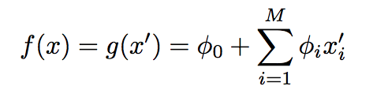
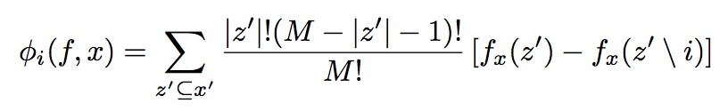

Slide 19
Additive feature attribution methods
LIME
DeepLIFT
Shapley reg. values
Relevance prop.
QII
Shapley sampling
Path expectations
Notes:
A number of current methods XX have not previously considered these properties and the uniqueness result they imply, and this has important implications for each of them. In contrast, XX methods already connected with game theory are consistent with these properties, but are less efficient to compute than these other approaches. XX

Slide 20
LIME
DeepLIFT
SHAP
Shapley reg. values
Relevance prop.
QII
Shapley sampling
Path expectations
Notes:
We propose a unification of these approaches that leverages the unique strengths of each.
This unified approach presents a set of ideal values, SHAP values, that can then be approximated by different methods. What are these values? XX

Slide 21
SHapley Additive exPlanation (SHAP) values
Base rate
Prediction for John
20%
55%
How did we get here?
Notes:
To see, let’s return to John and answer why his loan application was denied. To explain his denial it is important to start with the base rate of loan repayment problems XX, denoted here by the expected value of the model’s output.
To explain John's risk XX, we need to explain how we got from the base rate XX, to his risk of 55%. XX

Slide 22
SHapley Additive exPlanation (SHAP) values
20%
35%
55%
70%
90%
Base rate
Day trader
Open accounts = 1
Age = 20
Married
Notes:
To do this we start at the expected value of the model output, and then condition on a single feature XX, John's age. Since this increases John's risk by 15% we attribute that increase to John's age.
XX Next we condition on John's occupation, which is very unstable, and again attribute the change in expected model output to his occupation as a day trader.
If we repeat this for his open accounts XX and marital status XX we end up conditioning on all the features and so arrive at 55%, John’s predicted risk. XX

Slide 23
SHapley Additive exPlanation (SHAP) values
The order matters!
SHAP values result from averaging over all N! possible orderings.
Day trader
Age = 20
Notes:
It is important to note that in this process the order matters! For example the impact of John being a day trader might be particularly bad because he is also young. Which means if we reversed the order that we added age and occupation, their marginal effects would be different.
XX SHAP values result from averaging over all N! possible orderings. Of course this not how we want to actually compute the values, but we will discuss that later. XX

Slide 24
DeepLift

Slide 25


How can we find the important parts of the input for a given prediction?
Idea 1: perturbation
Examples
Zeiler & Fergus, 2013
LIME (Ribeiro et al., 2016)
Zintgraf et al., 2017
Output
…
…
Drawbacks
1) Computational efficiency - requires one forward prop for each perturbation
2) Saturation
…
…
Yellow = inputs
Notes:
Let’s talk about approaches that one might take to obtain these importance scores. Perhaps the most intuitive are perturbation-based approaches. These approaches work by making a perturbation to the input and observing the change in the output. This is repeated for different perturbations of the input, each time observing the change in the output. There are several approaches that fall into this family, one of the earliest being by Zeiler & Fergus in 2013 where they had a sliding window occlude different parts of the image and looked at the change in the output. LIME also falls into this category, where a linear model is built to approximate the local behaviour of the network using data gathered from making input perturbations. A common drawback to perturbation-based approaches is computational efficiency; every time you make a perturbation, you have to recompute the outputs using a forward propagation. Another more subtle issue is one of saturation, and I’ll talk more about it in the next slide.

Slide 26
Saturation problem illustrated
y
=1
1
y
1
2
i₁
i₂
0
=1
=1
i₁ + i₂
0
Avoiding saturation means perturbing combinations of inputs → increased computational cost
Notes:
Consider the output y which is a function of the inputs i1 and i2. When i1 + i2 is greater than 1, the output y saturates to 1. Consider the point where i1=1 and i2=1. If at this point I perturb i1 from 1 to 0, I won’t observe a change in the output, because at this point the output y is locally insensitive to the inputs. This can give me the misleading impression that neither i1 nor i2 is relevant to the output y. To avoid this saturation effect, I’d have to perturb combinations of inputs which in turn increases computational cost.

Slide 27
How can we find the important parts of the input for a given prediction?
Idea 2: backpropagate importance
Output
Examples:
Gradients (Simonyan et al.)
Deconvolutional Networks (Zeiler & Fergus)
Guided Backpropagation (Springenberg et al.)
Layerwise Relevance Propagation (Bach et al.)
Integrated Gradients (Sundararajan et al.)
DeepLIFT (Learning Important FeaTures)
https://github.com/kundajelab/deeplift
…
…
…
…
Yellow = inputs
Notes:
Another family of approaches that addresses the computational efficiency issue is what I will refer to as backpropagation-based approaches. In these approaches, you look at the function connecting the output to the neurons in the layer below and assign contribution scores to those neurons to represent how much they affected the output. You then repeat this process backing down through the layers until you reach the input. The reason this is efficient is that in a single backwards pass, you get importance scores for your entire input. There are a number of approaches that fall into this category and the most well-known is simply computing the gradients of the output with respect to the input, because this will give you a sense of which parts of the input the output is most sensitive to. The other approaches listed here are closely related to taking the gradients, and it turns out that they all have limitations that come from this connection to taking the gradients which essentially boil down to the fact that gradients describe only the local behaviour of a function. To address these limitations, we developed DeepLIFT, that’s Deep Learning Important Features, and you should feel free to check out our code online.

Slide 28
Saturation revisited
When (i₁ + i₂) >= 1,
gradient is 0
y
=1
1
y
i₁
=1
i₂
=1
0
1
2
i₁ + i₂
Affects:
Gradients
Deconvolutional Networks
Guided Backpropagation
Layerwise Relevance Propagation
Notes:
Ok, so why are gradients problematic? Let’s revisit the saturation example. Note that when i1+i2 > 1, the gradient of y with respect to i1 and i2 is zero - in fact, this is what saturation means by definition. Thus, using the gradients would once again flag neither i1 nor i2 as important. This issue also affects deconvolutional networks, guided backpropagation and layerwise relevance propagation, again for very similar reasons.

Slide 29
The DeepLIFT solution: difference from reference
Reference: i₁⁰=0 & i₂⁰=0
y
=1
y⁰=0 as (i₁⁰ + i₂⁰) = 0 (reference)
1
With (i₁ + i₂) = 2, the “difference from reference” (Δy) is +1, NOT 0
y
i₁
=1
i₂
1
=1
0
2
i₁ + i₂
Δi₁=1
Δi₂=1
C_{Δi1Δy}=0.5=C_{Δi2Δy}
See paper for detailed backpropagation rules
Notes:
How does DeepLIFT get around this? We rely on the concept of the difference from a “reference” activation, where the “reference” activation is the activation that the neuron has when presented with the “reference” or “neutral” input - and we’ll talk about that more in a moment. For this example, let’s assume that our inputs are mean and variance normalized so a reasonable “reference” value is 0 for for i1 and i2. Note that when i1+i2 is 0, the activation if the hidden unit is 1 due to the positive bias term. Now, when we look at the point where i1+i2 is 2, the “difference from the reference” is -1 even though the gradient locally might be 0. This is the information that we use to propagation importance even when the gradient is zero. Now, I’ll be the first to admit that choosing the reference can be tricky, but we’ve found that for genomics, using an input that reflects the average gc-content of the negative set can work fairly well, and one thing we want to explore is having different references for different types of regions that have very different GC-contents – say one reference for promoters and one for enhancers.

Slide 30
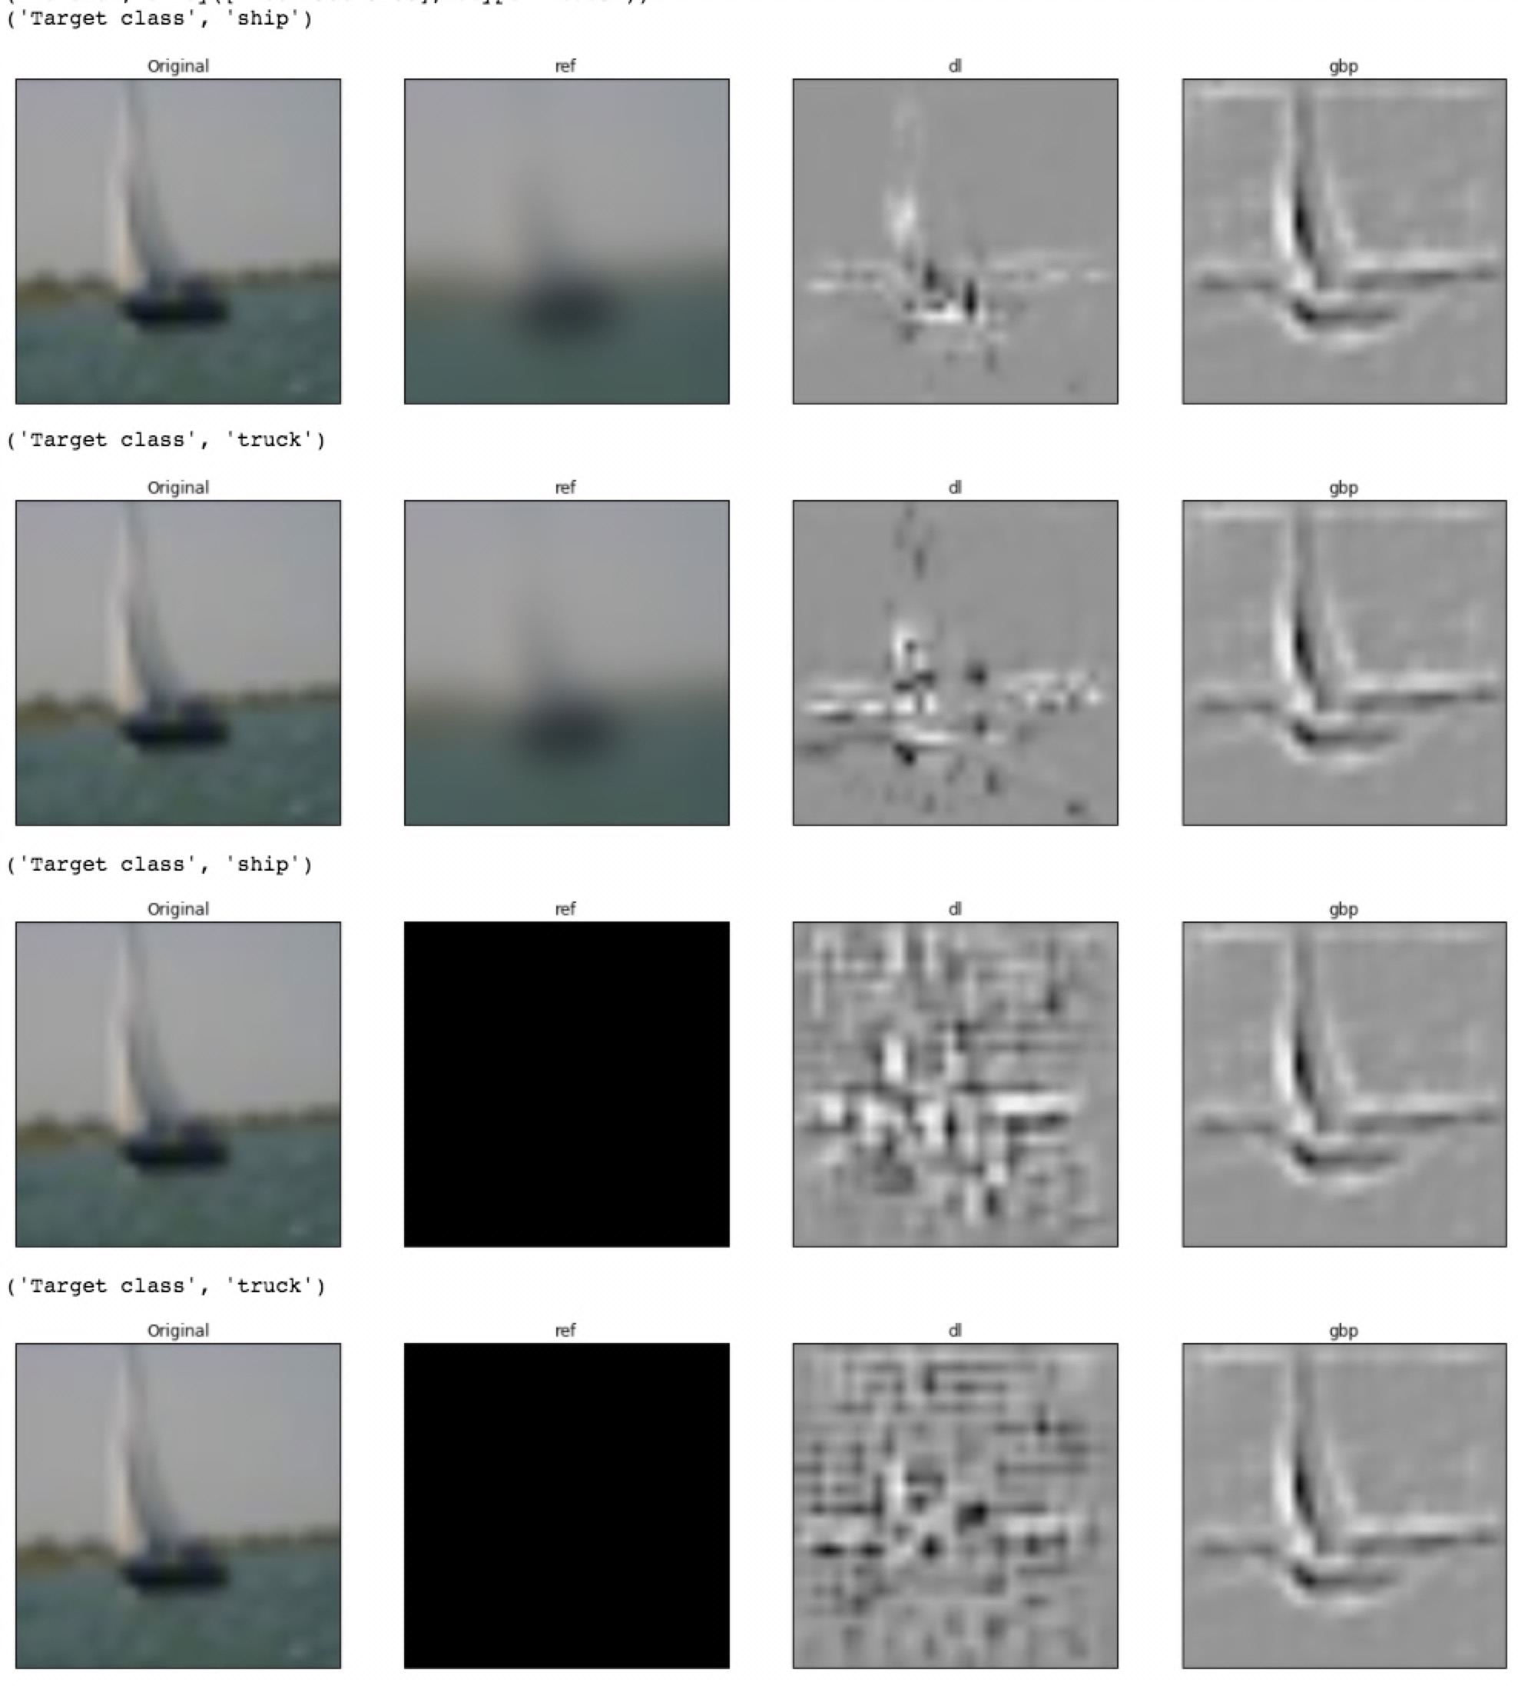
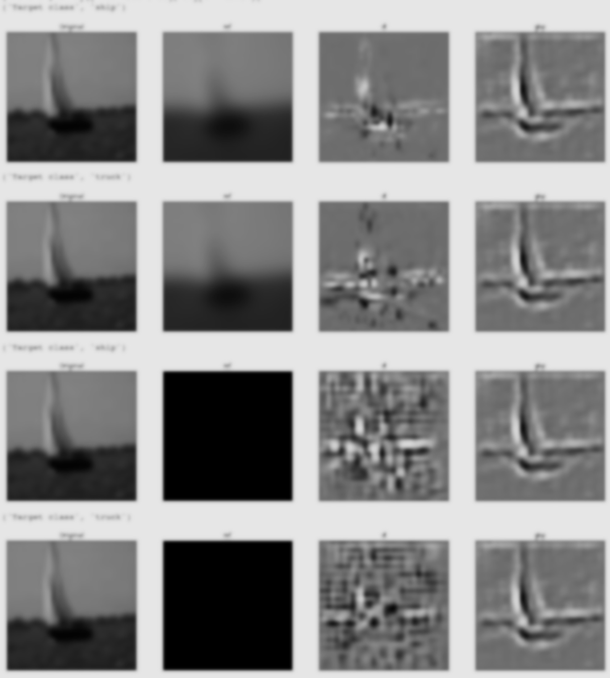
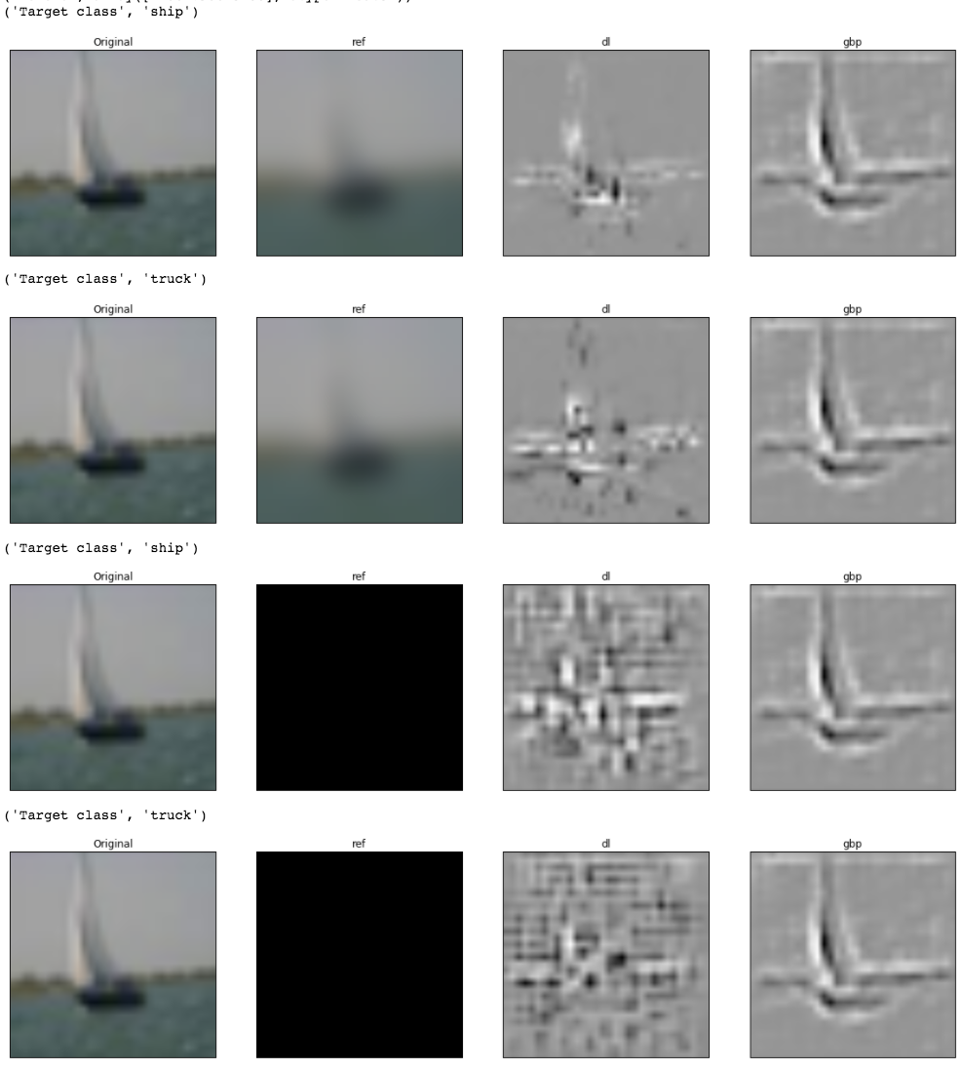
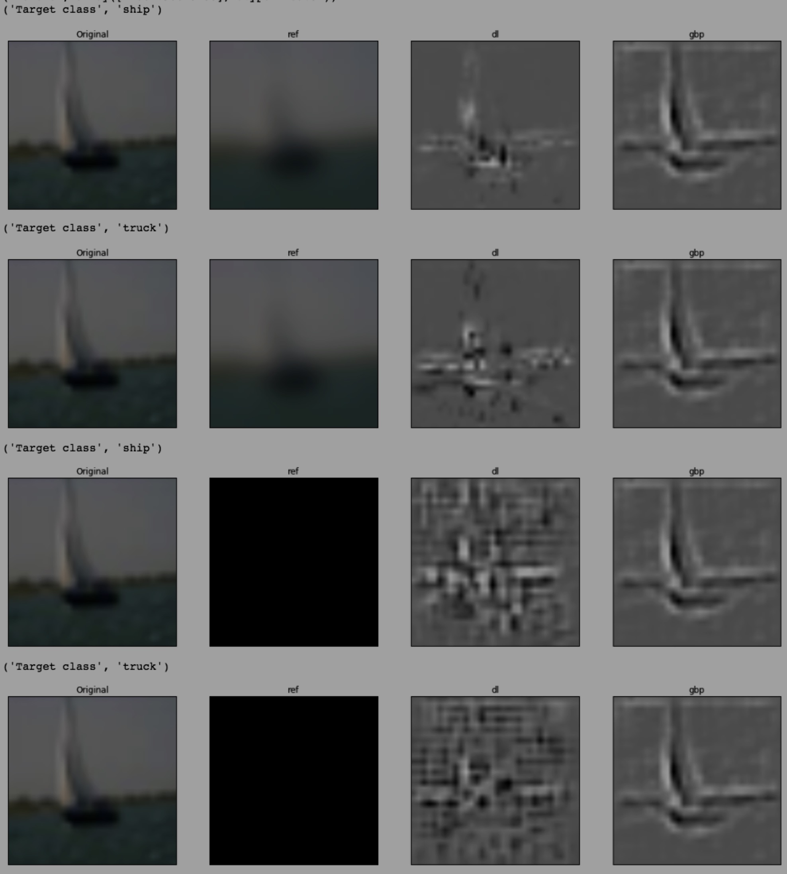
Choice of reference matters!
CIFAR10 model, class = “ship”
DeepLIFT scores
Suggestions on how to pick a reference:
MNIST: all zeros (background)
Consider using a distribution of references
E.g. multiple references generated by shuffling a genomic sequence
Original
Reference

Slide 31
Integrated gradients

Slide 32
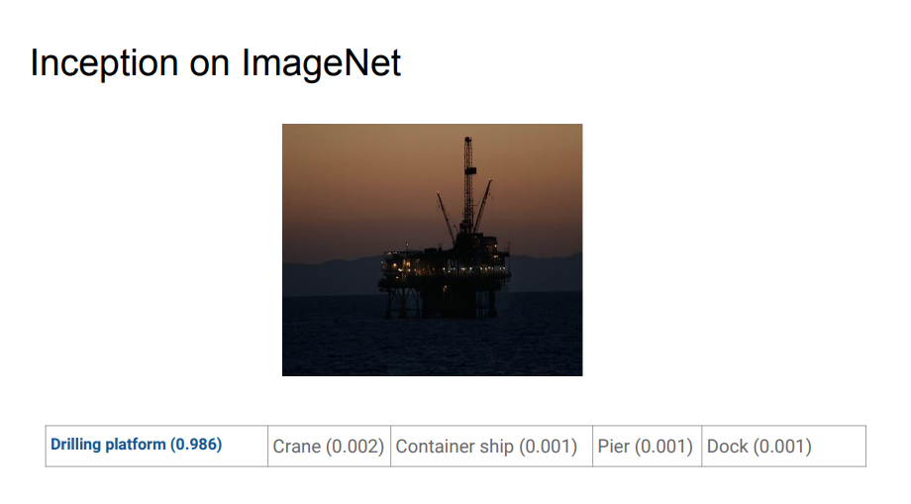

Slide 33
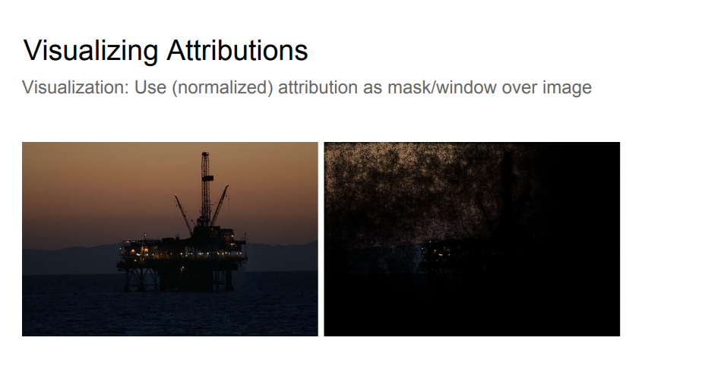

Slide 34
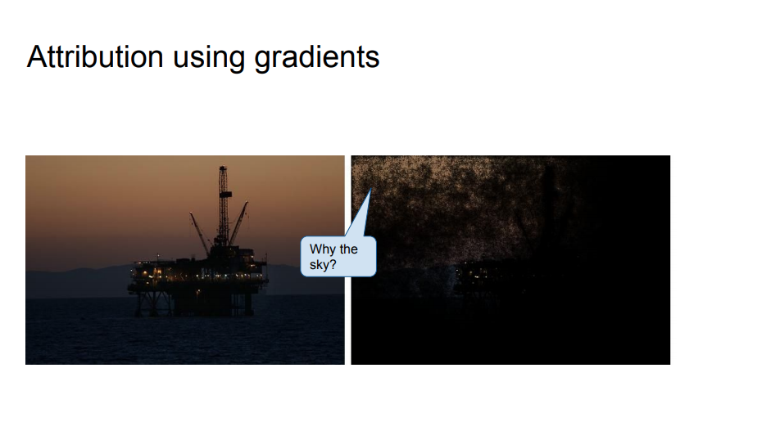
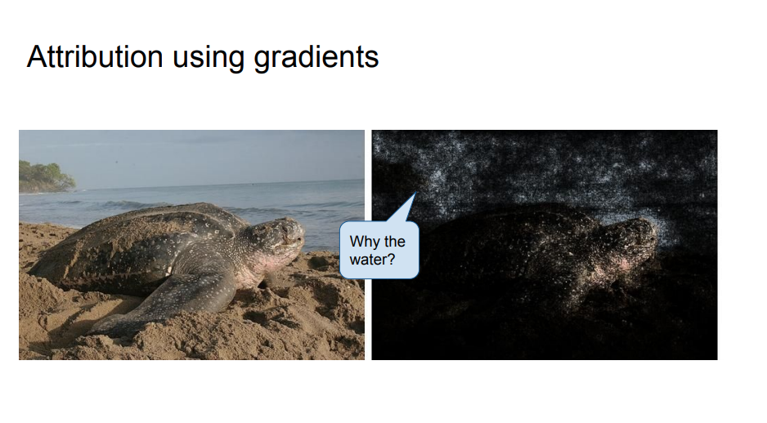

Slide 35
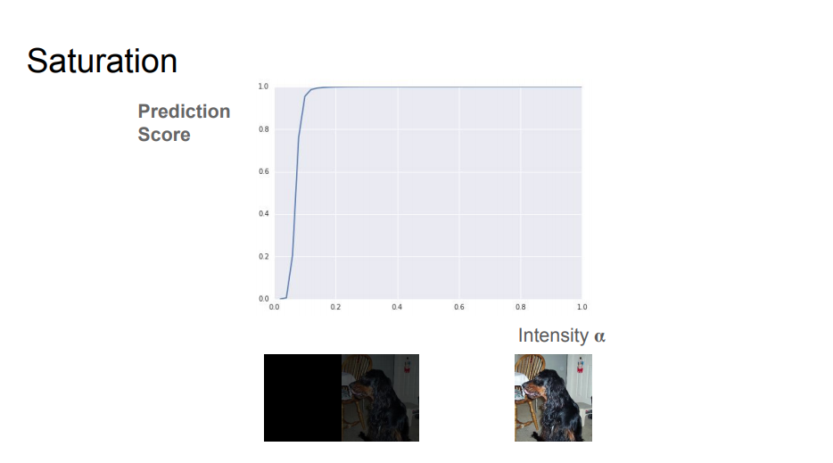

Slide 36
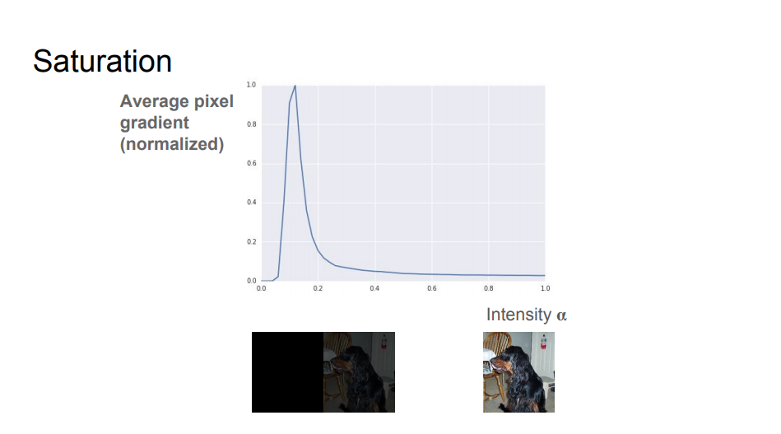

Slide 37
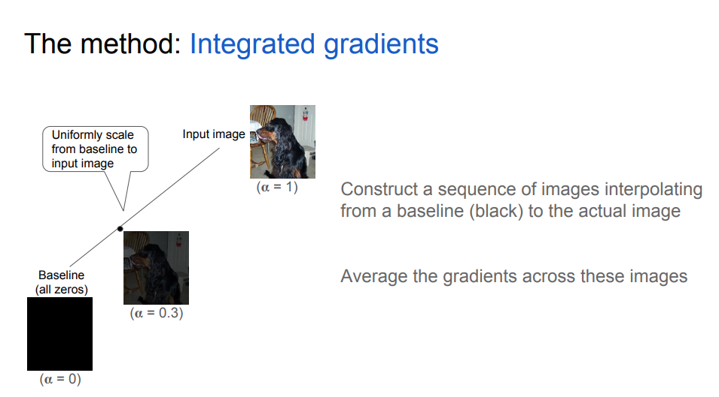

Slide 38
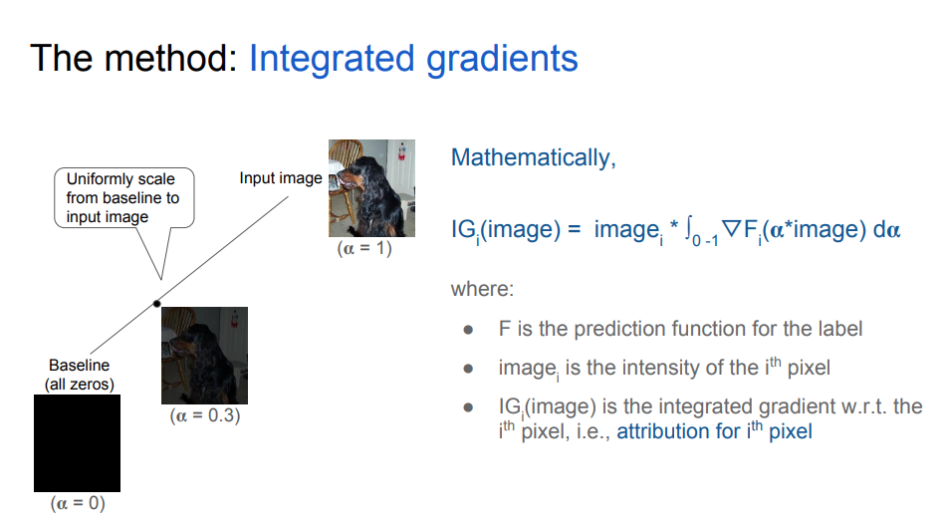

Slide 39
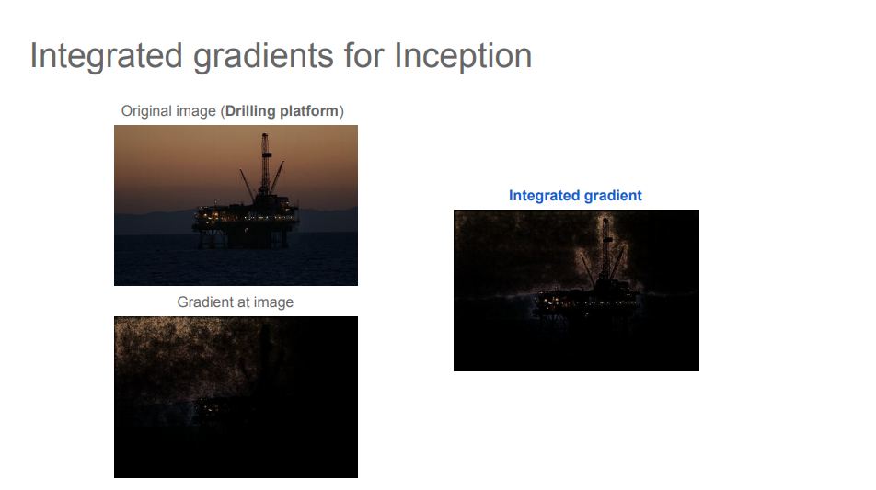

Slide 40
